Slide 1


Data Link layer

Slide 2
Data Link Layer
Understanding the Bridge Between Physical and Network Layers
"Acts as the neighbourhood traffic cop of network communication“
Position: Between Physical Layer (Layer 1) and Network Layer (Layer 3)
Primary Purpose: Ensure reliable data transfer between directly connected nodes
Scope: Local delivery within the same network segment
Key Responsibility: Node-to-node delivery with error detection and flow control

Slide 3
Data Link Layer
Core Responsibilities of Data Link Layer
Framing - Organizing bits into manageable frames
Addressing - Physical addressing using MAC addresses
Error Detection & Correction - Ensuring data integrity
Flow Control - Managing data transmission rate
Access Control - Managing shared medium access
Synchronization - Coordinating sender and receiver

Slide 4
Data Link Layer
Data Link Layer Sub-layers
Logical Link Control (LLC)
• Upper sub-layer
• Protocol multiplexing and demultiplexing
• Flow control and error checking
• Interface between MAC and Network Layer
Media Access Control (MAC)
• Lower sub-layer
• Physical addressing (MAC addresses)
• Media access management
• Frame encapsulation and validation
Notes:
Multiplexing is the process of combining multiple data streams or applications into a single stream for transmission over the network.
Demultiplexing is the process of separating the received combined stream back into individual application data streams.

Slide 5
Data Link Layer
LLC Sub-layer Functions
• Multiplexing: Multiple protocols over MAC layer
• Flow Control: Coordinates data transmission rate
• Error Control: Detects frame loss and requests retransmission
Acknowledgment Tracking: Monitors successful frame delivery
Interface Role: Acts as bridge between upper layers and MAC sub-layer

Slide 6
Data Link Layer
MAC Sub-layer Functions
Media Access Control Details
Core Functions:
• Physical Addressing: Unique MAC address identification
• Frame Encapsulation: Adds headers and trailers
• Medium Access: Coordinates shared channel usage
• Collision Management: Handles multiple access scenarios
MAC Address: 48-bit unique identifier assigned at manufacturing

Slide 7
Data Link Layer
Framing Process
Converting Packets to Frames
What is Framing?
• Dividing data into manageable units called frames
• Adding headers and trailers for identification and control
• Enabling frame boundary recognition
Frame Structure:
• Header: Source/destination addresses, control information
• Payload: Actual data from upper layers
• Trailer: Error detection bits, end markers

Slide 8
Data Link Layer
Types of Framing
Fixed vs Variable Size Framing
Fixed-Size Framing
• Characteristics: Constant frame size
• Advantages: Simple boundary detection
• Examples: ATM cells (53 bytes)
• Use Cases: Wide Area Networks (WAN)
Variable-Size Framing
• Characteristics: Flexible frame sizes
• Boundary Methods: Length fields or delimiters
• Examples: Ethernet frames
• Use Cases: Local Area Networks (LAN)

Slide 9
Data Link Layer
Error Types
Single-Bit Errors
• Only one bit changed during transmission
• Example: 1010 becomes 1000
• Common in high-quality channels
Burst Errors
• Multiple consecutive bits corrupted
• Example: 1011101 becomes 1000001
• Common in wireless environments
• More challenging to detect and correct

Slide 10
Data Link Layer
Error Detection Techniques: Ensuring Data Integrity
Hamming Distance
Count the number of dissimilar bits of the given 2 numbers
Simple/Single Parity Check
Adds a single parity bit
Detects single-bit errors only
Even or odd parity systems
Checksum
Mathematical sum of data segments
Detects multiple-bit errors
1's complement arithmetic

Slide 11
Data Link Layer
Cyclic Redundancy Check (CRC)
• Polynomial-based error detection
• Highly effective for burst errors
• Widely used in modern networks

Slide 12
SIMPLE/ SINGLE PARITY CHECK
Parity means in terms of the count of 1’s
Two types: Odd and Even
In this technique, a redundant bit called a parity bit is appended to every data unit so that the number of 1’s in the unit, including the parity, becomes even.
Blocks of data from the source are subjected to a check bit or parity bit generator form, where a parity of:
    1 is added to the block if it contains an odd number of 1’s, and
    0 is added if it contains an even number of 1’s.
This scheme makes the total number of 1’s even, which is why it is called even parity checking.

Slide 13
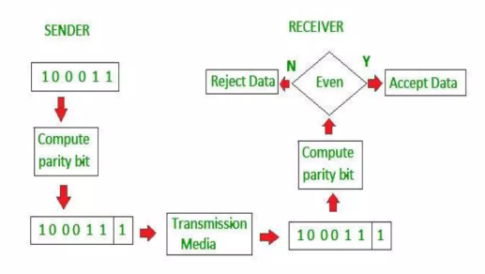

Slide 14
Checksum (CHECK THE SUM)
Sender’s End:
The data is divided into k segments, each of m bits.
On the sender’s end, the segments are added using 1’s complement arithmetic to get the sum.
The sum is complemented to get the checksum.
The checksum segment is sent along with the data segments.
Receiver’s End:
At the receiver’s end, all received segments are added using 1’s complement arithmetic to get the sum. The sum is complemented.
If the result is zero, the received data is accepted; otherwise, it is discarded.

Slide 15
Performance
The checksum detects all errors involving an odd number of bits.
It also detects most errors involving an even number of bits.

Slide 16
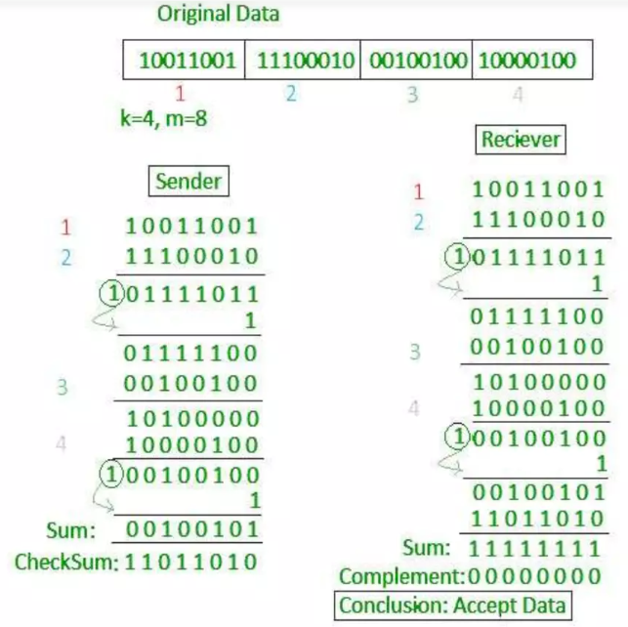

Slide 17
Cyclic Redundancy Check (CRC)
CRC is the most powerful and easiest to implement technique
CRC is based on binary division.
The divisor is generated using polynomials.
It is commonly used to detect accidental changes to data transmitted via telecommunications networks and storage devices.

Slide 18
The sender performs a division operation on the bits being sent and calculates the remainder.
Before sending the actual bits, the sender adds the remainder at the end of the actual bits.
Actual data bits plus the remainder are called a codeword. The sender transmits data bits as codewords.
At the other end, the receiver performs a division operation on codewords using the same CRC divisor.
If the remainder contains all zeros, the data bits are accepted; otherwise, it is considered that some data corruption occurred in transit.

Slide 19
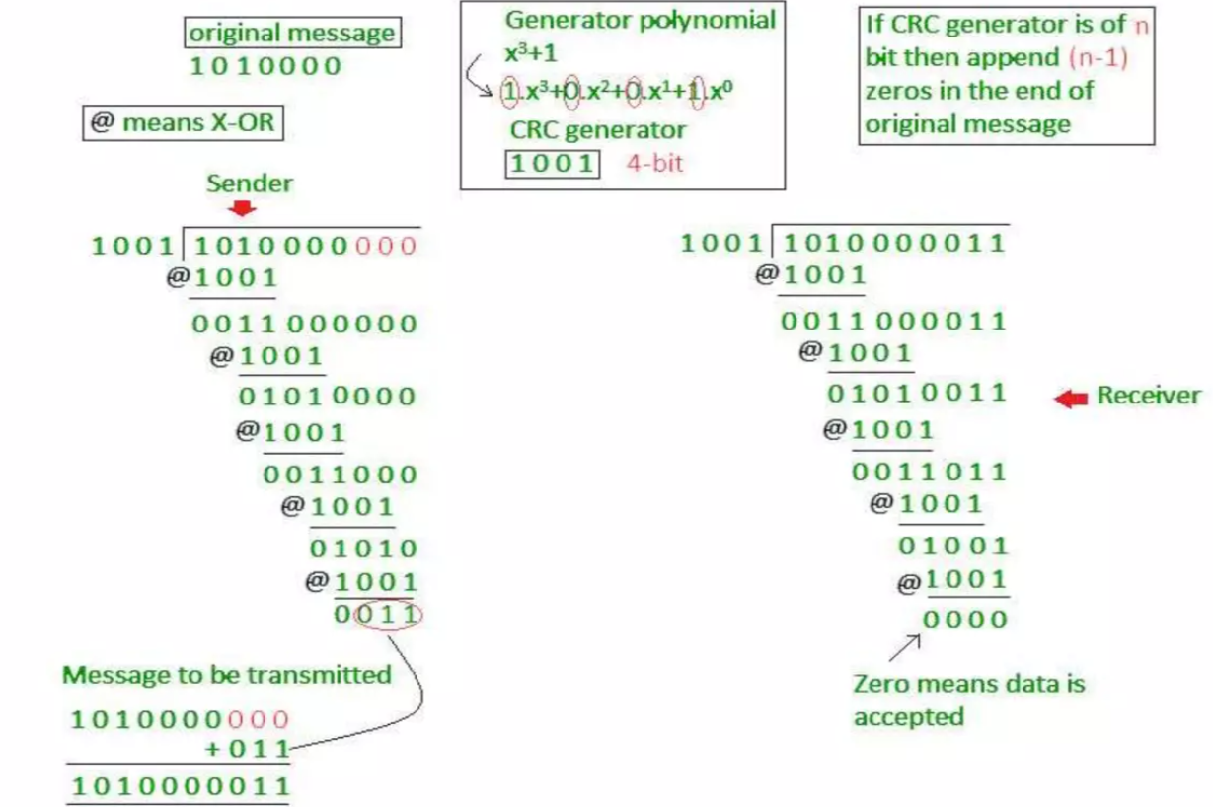

Slide 20
Data Link Layer
Access Control Methods: Managing Shared Medium Access
CSMA/CD (Collision Detection)
• Used in wired Ethernet networks
• Listen before transmitting
• Detect collisions and retransmit
• Process: Sense → Transmit → Detect → Backoff → Retry
CSMA/CA (Collision Avoidance)
• Used in wireless networks (WiFi)
• Avoid collisions through coordination
• Mechanisms: RTS/CTS, Interframe spacing

Slide 21
Data Link Layer
CSMA/CD vs CSMA/CA
Aspect | CSMA/CD | CSMA/CA
Usage | Wired Ethernet | Wireless Networks
Collision Handling | Detect after occurrence | Avoid before occurrence
Efficiency | Higher throughput | Lower overhead in wireless
Complexity | Simpler | More complex protocols
Reliability | Direct collision detection | Acknowledgment-based

Slide 22
Data Link Layer
When nodes or stations are connected and use a common link, called a multipoint or broadcast link, a multiple-access protocol is needed to coordinate access to the link.
The problem of controlling access to the medium is like the rules of speaking in an assembly.
The procedures guarantee that the right to speak is upheld and ensure that two people do not talk at the same time, do not interrupt each other, do not monopolize the discussion, and so on

Slide 23
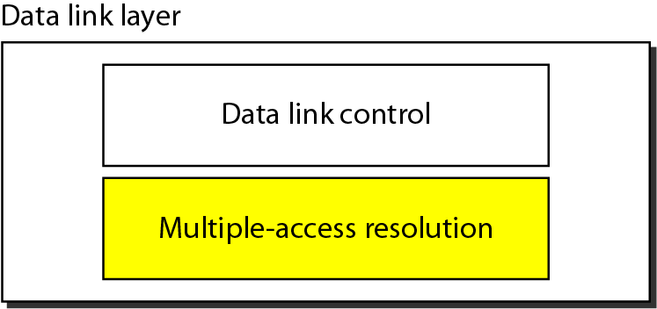
Data link layer divided into two functionality-oriented sublayers
Or Logical link control and MAC

Slide 24
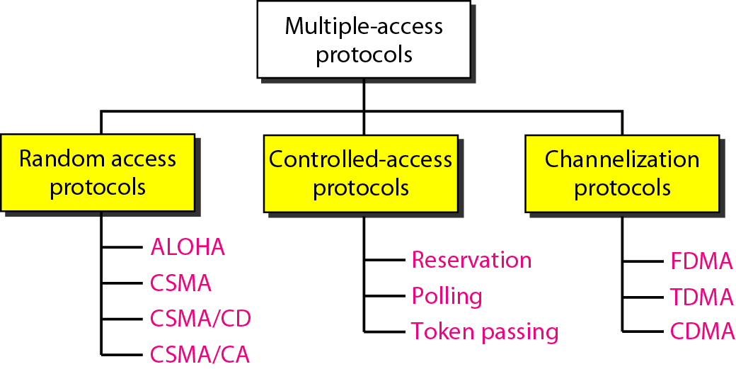
Taxonomy of multiple-access protocols discussed in this chapter

Slide 25
RANDOM ACCESS
In random access or contention methods, no station is superior to another station, and none is assigned the control over another. No station permits, or does not permit, another station to send. At each instance, a station that has data to send uses a procedure defined by the protocol to make a decision on whether or not to send.
Topics discussed in this section:
ALOHA
Carrier Sense Multiple Access
Carrier Sense Multiple Access with Collision Detection
Carrier Sense Multiple Access with Collision Avoidance

Slide 26
Random Access
In random-access or contention methods, no station is superior to another station, and none is assigned control over another.
At each instance, a station that has data to send uses a procedure defined by the protocol to make a decision on whether or not to send.
This decision depends on the state of the medium (idle or busy). In other words, each station can transmit when it desires on the condition that it follows the predefined procedure, including testing the state of the medium.

Slide 27
Random Access
Two features give this method its name.
First, there is no scheduled time for a station to transmit. Transmission is random among the stations.
That is why these methods are called random access.
Second, no rules specify which station should send next. Stations compete with one another to access the medium.
That is why these methods are also called contention methods.

Slide 28
Random Access
In a random-access method, each station has the right to the medium without being controlled by any other station.
However, if more than one station tries to send, there is
an access conflict—collision—and the frames will be either destroyed or modified.
To avoid access conflict or to resolve it when it happens, each station follows a procedure that answers the following questions:
When can the station access the medium?
What can the station do if the medium is busy?
How can the station determine the success or failure of the transmission?
What can the station do if there is an access conflict?

Slide 29
ALOHA
ALOHA, the earliest random-access method, was developed at the University of Hawaii in early 1970.
It was designed for a radio (wireless) LAN, but it can be used on any shared medium.
It has an acknowledgement used for successful communication.
There are potential collisions in this arrangement. The medium is shared between the stations.
When a station sends data, another station may attempt to
do so at the same time. The data from the two stations collide and become garbled.

Slide 30
Pure ALOHA
The original ALOHA protocol is called pure ALOHA.
This is a simple but elegant protocol. The idea is that each station sends a frame whenever it has a frame to send (multiple access).
However, since there is only one channel to share, there is the possibility of collision between frames from different stations.
Consider only Transmission time (No propagation time).

Slide 31
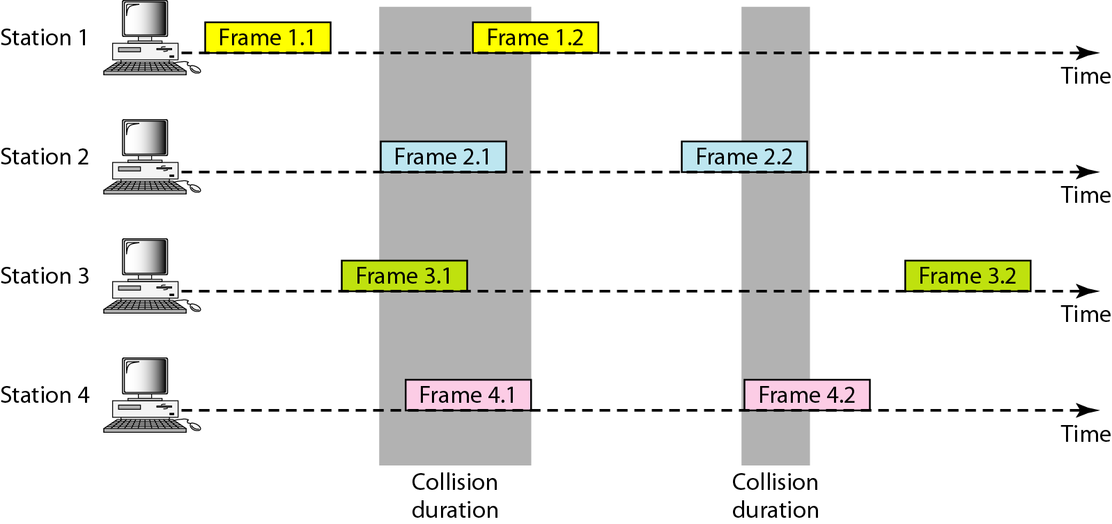
Frames in a pure ALOHA network

Slide 32
Pure ALOHA
The pure ALOHA protocol relies on acknowledgments from the receiver. When a station sends a frame, it expects the receiver to send an acknowledgment.
If the acknowledgment does not arrive after a time-out period, the station assumes that the frame (or the acknowledgment) has been destroyed and resends the frame.
A collision involves two or more stations. If all these stations try to resend their frames after the time-out, the frames will collide again.
Transmission Time = Message length/ Bandwidth

Slide 33
Pure ALOHA
Pure ALOHA dictates that when the time-out period passes, each station waits a random amount of time before resending its frame. The randomness will help avoid more collisions.
We call this time the backoff time, TB.
The backoff time TB is a random value that normally depends
on K (the number of attempted unsuccessful transmissions).
Propagation time is the time required for a frame to travel from source to destination, Tp
The time-out period is equal to the maximum possible round-trip propagation delay, which is twice the amount of time required to send a frame between the two most widely separated stations
Time Period = 2 × Tp.

Slide 34
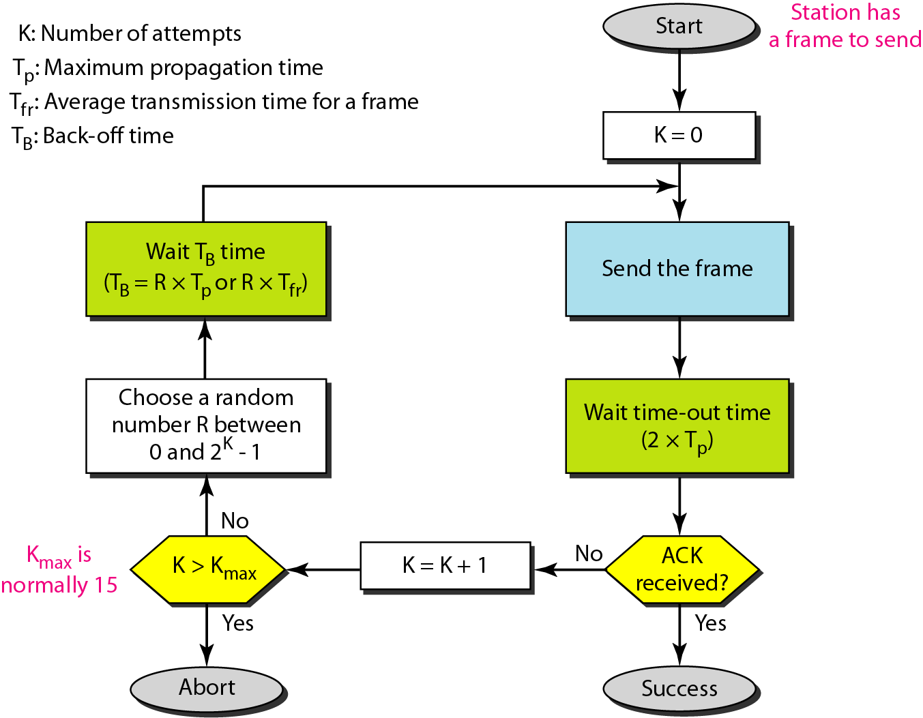
Procedure for pure ALOHA protocol

Slide 35
Example 12.1
The stations on a wireless ALOHA network are a maximum of 600 km apart. If we assume that signals propagate at 3 × 10⁸ m/s, we find
T_{p} = (600 × 10⁵ ) / (3 × 10⁸ ) = 2 ms.
Now we can find the value of T_{B} for different values of
K .
a. For K = 1, the range is {0, 1}. The station needs to
generate a random number with a value of 0 or 1. This
means that T_{B} is either 0 ms (0 × 2) or 2 ms (1 × 2),
based on the outcome of the random variable.

Slide 36
Example 12.1 (continued)
b. For K = 2, the range is {0, 1, 2, 3}. This means that T_{B}
can be 0, 2, 4, or 6 ms, based on the outcome of the
random variable.
c. For K = 3, the range is {0, 1, 2, 3, 4, 5, 6, 7}. This
means that T_{B} can be 0, 2, 4, . . . , 14 ms, based on the
outcome of the random variable.
d. We need to mention that if K > 10, it is normally set to
10.

Slide 37
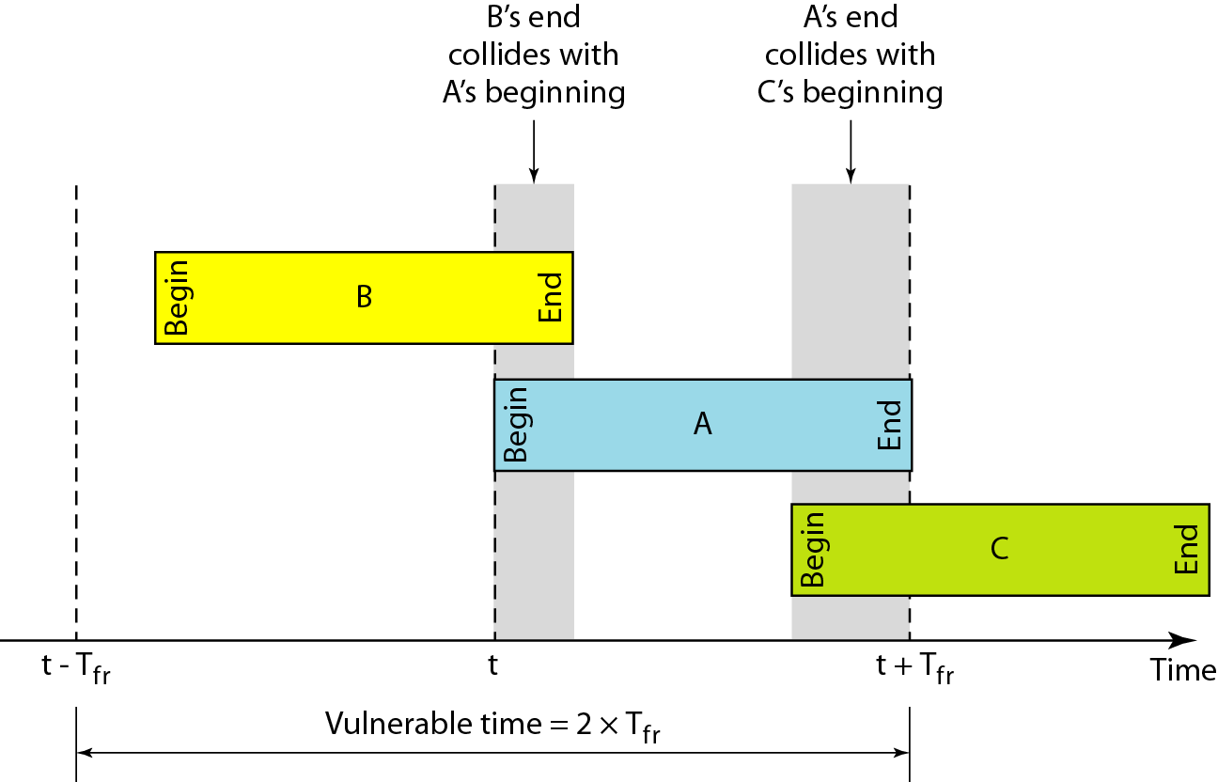
Vulnerable time for pure ALOHA protocol
the length of time in which there is a possibility of collision.
The stations send fixed-length frames with each frame taking Tfr seconds to send.

Slide 38
ALOHA
Vulnerable time during which a collision may occur in pure ALOHA is 2 times the frame transmission time.
Pure ALOHA vulnerable time = 2 × T_{fr} or ( 2 × Tt )
Throughput
Let us call G the average number of frames generated by the system during one frame transmission time.
Then it can be proven that the average number of successfully transmitted frames for pure ALOHA is S = G × e ^{−2G}

Slide 39
Example 12.2
A pure ALOHA network transmits 200-bit frames on a shared channel of 200 kbps. What is the requirement to make this frame collision-free?
Solution
Average frame transmission time T_{fr} is 200 bits/200 kbps or 1 ms. The vulnerable time is 2 × 1 ms = 2 ms.
This means no station should send later than 1 ms before this station starts transmission and no station should start sending during the one 1-ms period that this station is sending.

Slide 40

Note
The throughput for pure ALOHA is
S = G × e ^{−2G} .
The maximum throughput
S_{max} = 0.184 when G= (1/2).

Slide 41
Calculation of max efficiency/ throughput Pure ALOHA
S = G × e ^{−2G}
Differentiate it with respect to G
G × e^{−2G} (-2) + e^{−2G} (1) = 0 ; (to find the maximum value)
= e^{−2G} (-2G+1) =0
=(-2G+1) =0
= G =1/2
Now, solve the efficiency equation
Max efficiency (S_{max}) = 0.184

Slide 42
Example 12.3
A pure ALOHA network transmits 200-bit frames on a shared channel of 200 kbps. What is the throughput if the system (all stations together) produces
a. 1000 frames per second b. 500 frames per second
c. 250 frames per second.
Solution
The frame transmission time is 200/200 kbps or 1 ms.
a. If the system creates 1000 frames per second, this is 1
frame per millisecond. The load is 1. In this case
S = G× e^{−2 G} or S = 0.135 (13.5 percent). This means
that the throughput is 1000 × 0.135 = 135 frames. Only
135 frames out of 1000 will probably survive.

Slide 43
Example 12.3 (continued)
b. If the system creates 500 frames per second, this is
(1/2) frame per millisecond. The load is (1/2). In this
case S = G × e ^{−2G} or S = 0.184 (18.4 percent). This
means that the throughput is 500 × 0.184 = 92 and that
only 92 frames out of 500 will probably survive. Note
that this is the maximum throughput case,
percentagewise.
c. If the system creates 250 frames per second, this is (1/4)
frame per millisecond. The load is (1/4). In this case
S = G × e −^{2G} or S = 0.152 (15.2 percent). This means
that the throughput is 250 × 0.152 = 38. Only 38
frames out of 250 will probably survive.

Slide 44
Slotted ALOHA
Pure ALOHA has a vulnerable time of 2 × Tfr.
This is so because there is no rule that defines when the station can send.
A station may send soon after another station has started or just before another station has finished.
Slotted ALOHA was invented to improve the efficiency of pure ALOHA.
In slotted ALOHA we divide the time into slots of T_{fr} seconds and force the station to send only at the beginning of the time slot.

Slide 45
Because a station is allowed to send only at the beginning of the synchronized time slot, if a station misses this moment, it must wait until the beginning of the next time slot.
This means that the station which started at the beginning of this slot has already finished sending its frame.
Of course, there is still the possibility of collision if two stations try to send at the beginning of the same time slot.
However, the vulnerable time is now reduced to one-half, equal to Tfr.

Slide 46
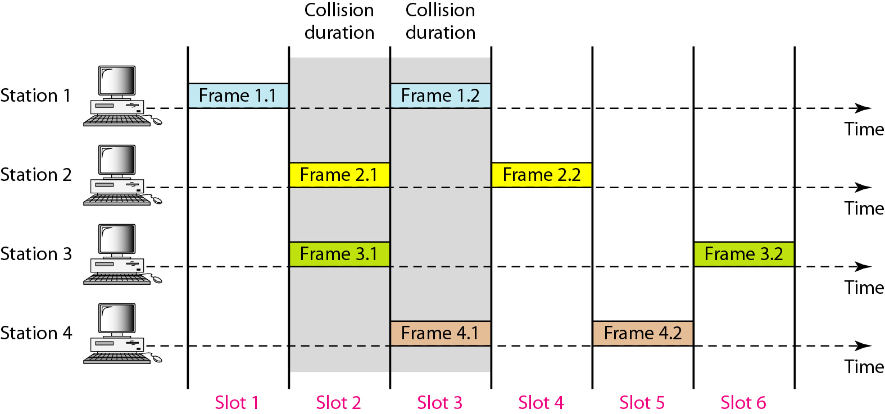
Figure 12.6 Frames in a slotted ALOHA network

Slide 47
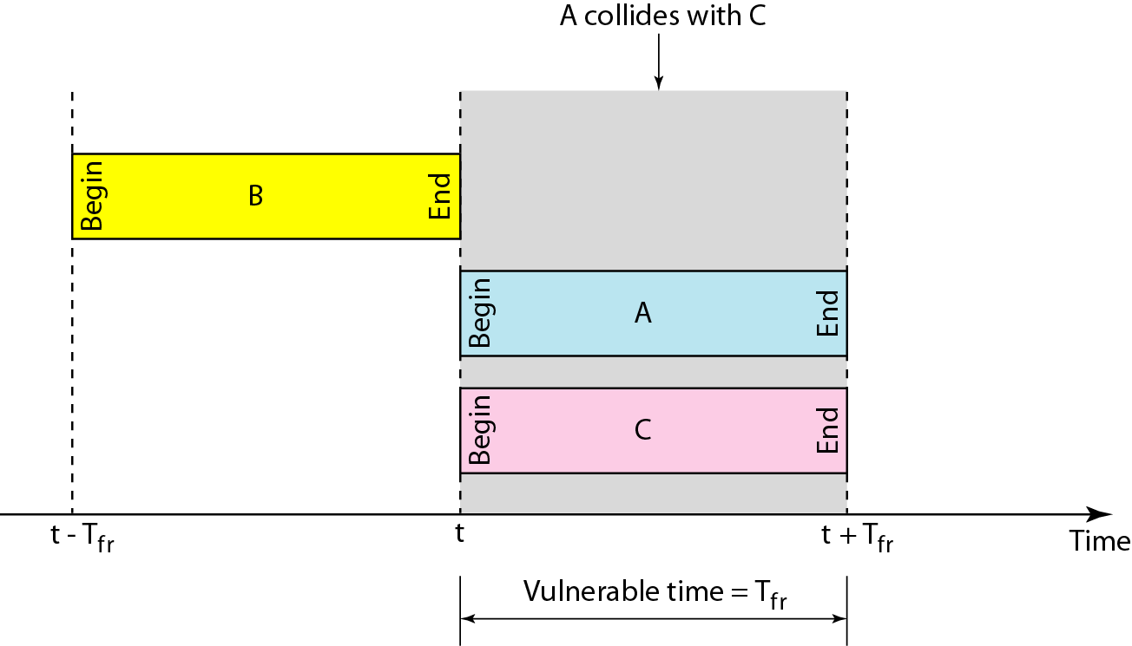
Figure 12.7 Vulnerable time for slotted ALOHA protocol

Slide 48
Slotted ALOHA vulnerable time = T_{fr} or (2 × T_{t} )
Throughput
It can be proven that the average number of successful transmissions for slotted ALOHA is:
S= G × e^{−G}.
The maximum throughput Smax is 0.368, when G = 1.

Slide 49
Note
The throughput for slotted ALOHA is
S = G × e^{−G} .
The maximum throughput
S_{max} = 0.368 when G = 1.

Slide 50
Example 12.4
A slotted ALOHA network transmits 200-bit frames on a shared channel of 200 kbps. What is the throughput of the system (all stations together) produces
a. 1000 frames per second b. 500 frames per second
c. 250 frames per second.
Solution
The frame transmission time is 200/200 kbps or 1 ms.
a. If the system creates 1000 frames per second, this is 1
frame per millisecond. The load is 1. In this case
S = G× e^{−G} or S = 0.368 (36.8 percent). This means
that the throughput is 1000 × 0.0368 = 368 frames.
Only 386 frames out of 1000 will probably survive.

Slide 51
Example 12.4 (continued)
b. If the system creates 500 frames per second, this is
(1/2) frame per millisecond. The load is (1/2). In this
case S = G × e^{−G} or S = 0.303 (30.3 percent). This
means that the throughput is 500 × 0.0303 = 151.
Only 151 frames out of 500 will probably survive.
c. If the system creates 250 frames per second, this is (1/4)
frame per millisecond. The load is (1/4). In this case
S = G × e ^{−G} or S = 0.195 (19.5 percent). This means
that the throughput is 250 × 0.195 = 49. Only 49
frames out of 250 will probably survive.

Slide 52
CSMA
In other words, CSMA is based on the principle “sense before transmit” or “listen before talk.”
To minimize the chance of collision and, therefore, increase the performance, the CSMA method was developed.
The chance of collision can be reduced if a station senses the medium before trying to use it.
Carrier sense multiple access (CSMA) requires that each station first listen to the medium (or check the state of the medium) before sending.
CSMA can reduce the possibility of collision, but it cannot eliminate it.

Slide 53
The possibility of collision still exists because of propagation delay; when a station sends a frame, it still takes time (although very short) for the first bit to reach every station and for every station to sense it.
In other words, a station may sense the medium and find it idle, only because the first bit sent by another station has not yet been received.

Slide 54
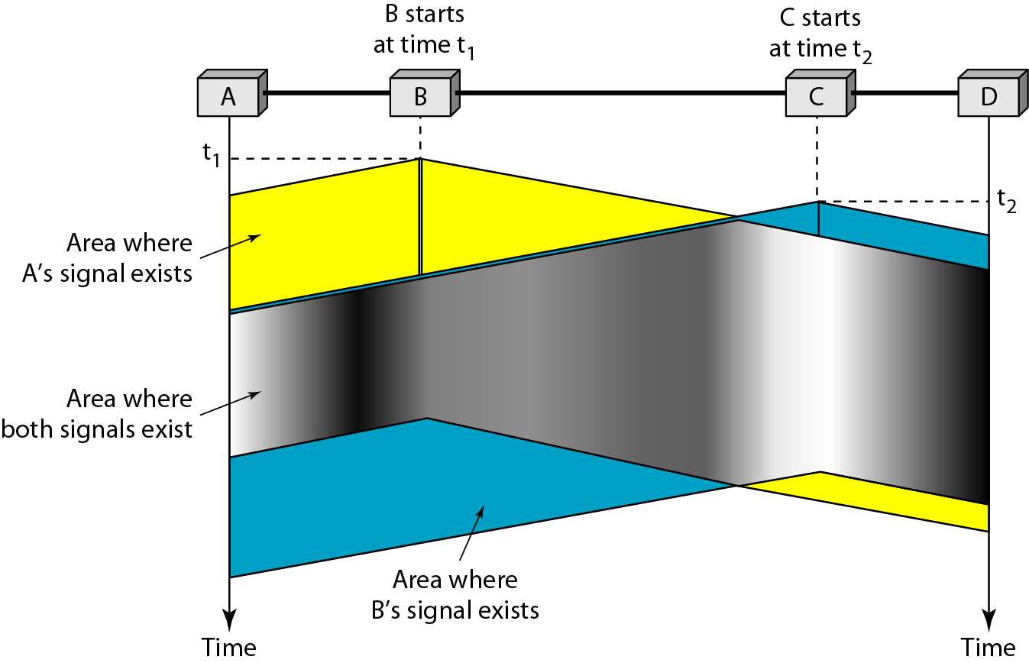
Figure 12.8 Space/time model of the collision in CSMA

Slide 55
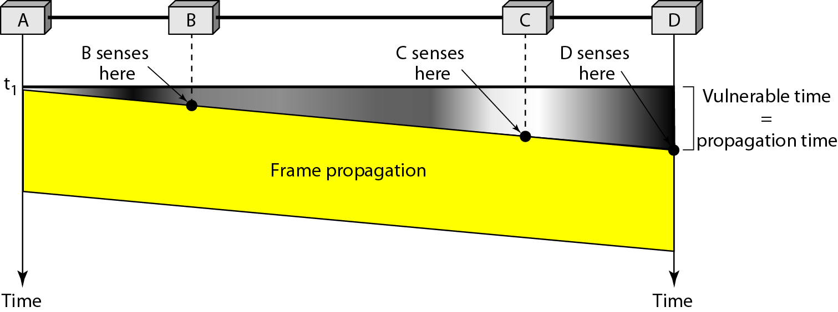
Figure 12.9 Vulnerable time in CSMA

Slide 56
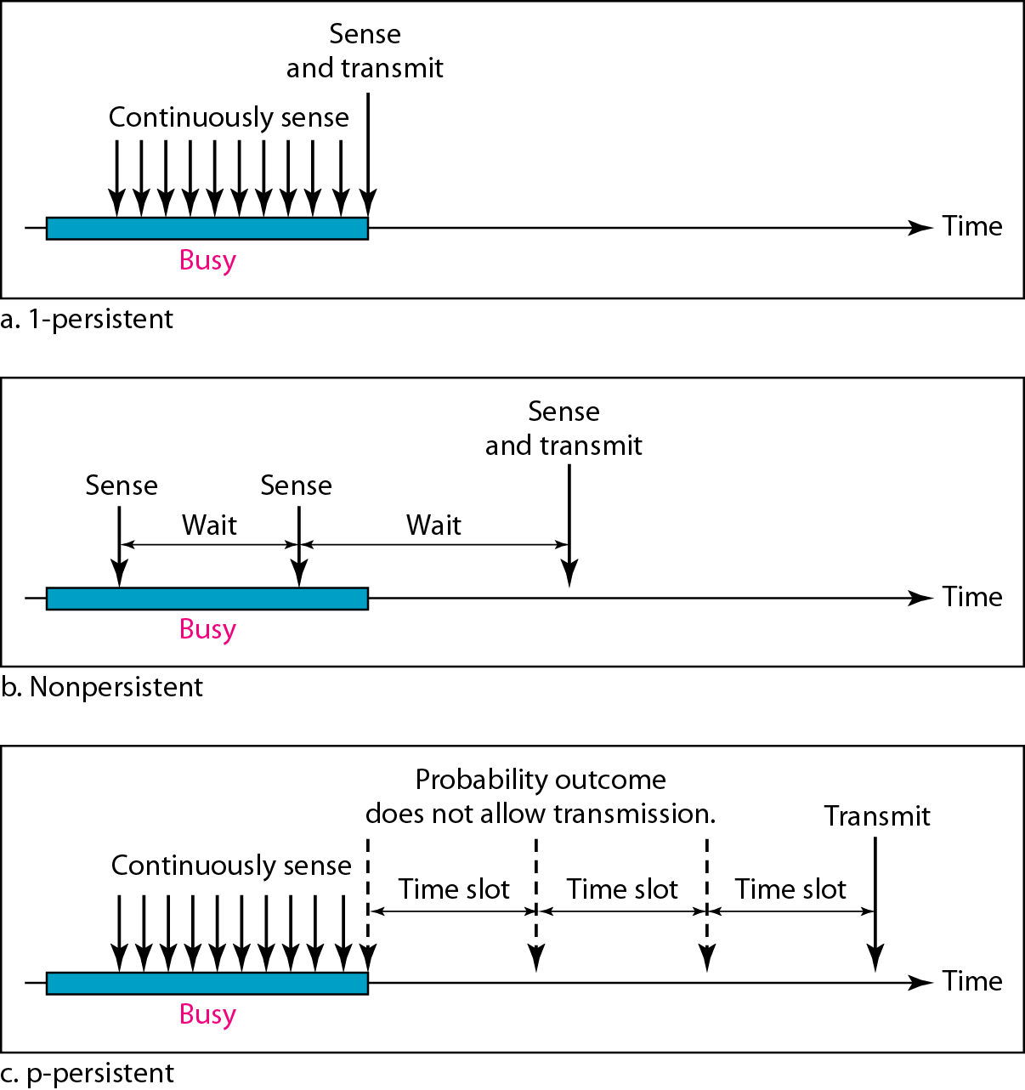
Figure 12.10 Behavior of three persistence methods

Slide 57
Kinds of CSMA
Unslotted Nonpersistent CSMA
Nonpersistent CSMA
Slotted Nonpersistent CSMA
CSMA
Unslotted persistent CSMA
Persistent CSMA
Slotted persistent CSMA
1-persistent CSMA
p-persistent CSMA

Slide 58
Nonpersistent/x-persistent CSMA Protocols
Nonpersistent (0 persistant) CSMA Protocol:
Step 1: If the medium is idle, transmit immediately
Step 2: If the medium is busy, wait a random amount of time and repeat Step 1
  Random backoff reduces probability of collisions
  Waste idle time if the backoff time is too long
1-persistent CSMA Protocol:
Step 1: If the medium is idle, transmit immediately
Step 2: If the medium is busy, continue to listen until medium becomes idle, and then transmit immediately
  There will always be a collision if two nodes want to retransmit
  (usually you stop transmission attempts after few tries)

Slide 59
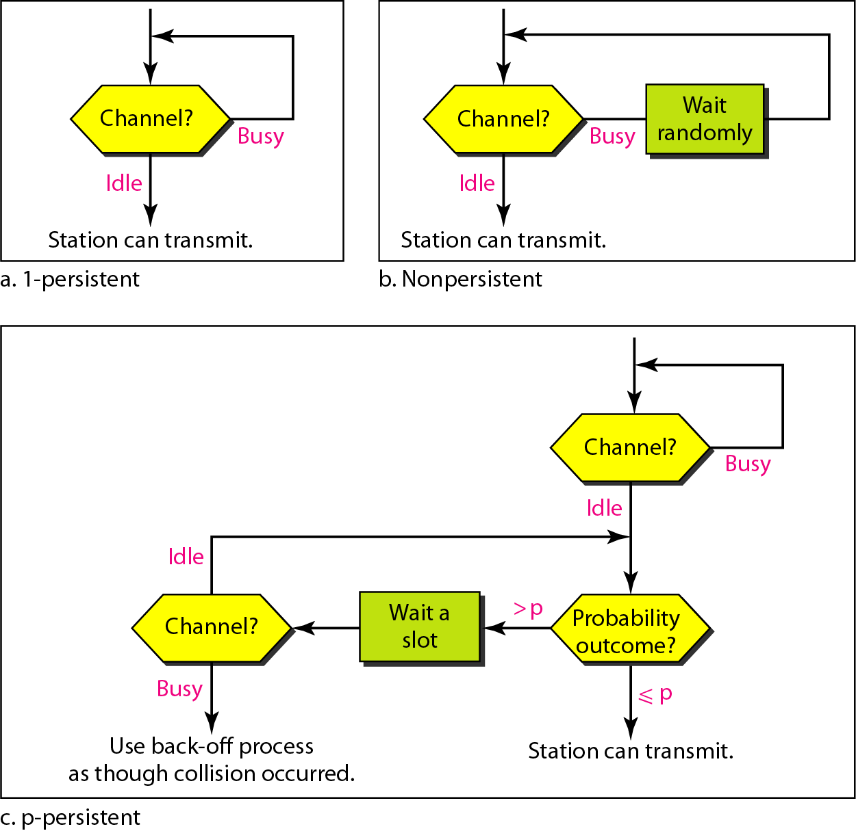
Figure 12.11 Flow diagram for three persistence methods

Slide 60
Nonpersistent/x-persistent CSMA Protocols
p-persistent CSMA Protocol:
Step 1: If the medium is idle, transmit with probability p, and delay for worst case propagation delay for one packet with probability (1-p)
Step 2: If the medium is busy, continue to listen until medium becomes idle, then go to Step 1
Step 3: If transmission is delayed by one time slot, continue with Step 1
  A good tradeoff between nonpersistent and 1-persistent CSMA

Slide 61
How to Select Probability p ?
Assume that N nodes have a packet to send and the medium is busy
Then, Np is the expected number of nodes that will attempt to transmit once the medium becomes idle
If Np > 1, then a collision is expected to occur
Therefore, network must make sure that Np < 1 to avoid collision, where N is the maximum number of nodes that can be active at a time

Slide 62
Throughput
1.0
0.9
0.8
0.7
0.6
0.5
0.4
0.3
0.2
0.1
0
0.01-persistent CSMA
Nonpersistent CSMA
0.1-persistent CSMA
0.5-persistent CSMA
S
1-persistent CSMA
Slotted Aloha
Aloha
0 1 2 3 4 5 6 7 8 9
G

Slide 63
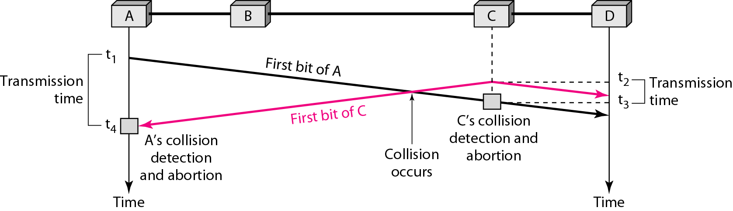
Figure 12.12 Collision of the first bit in CSMA/CD

Slide 64
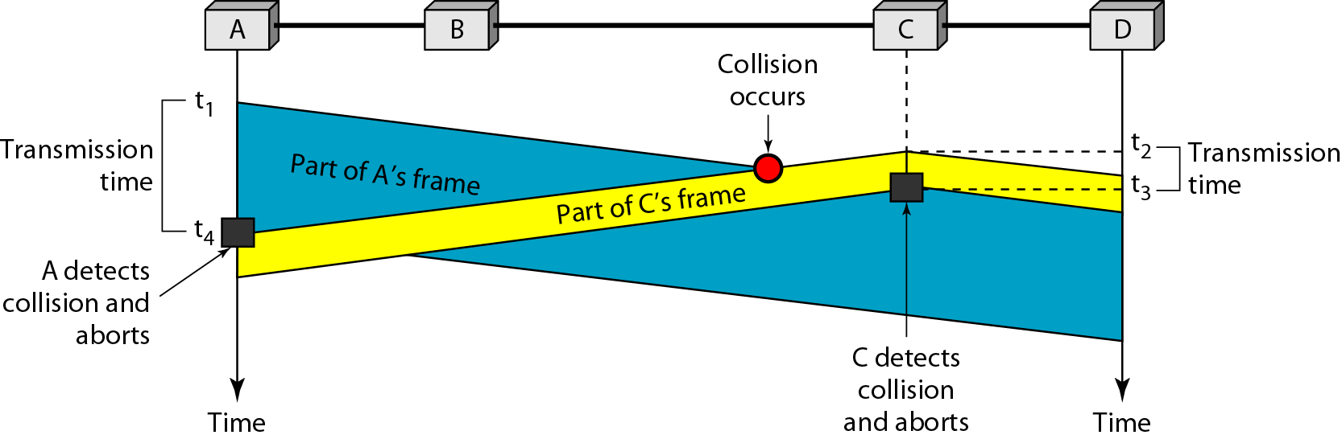
Figure 12.13 Collision and abortion in CSMA/CD

Slide 65
Example 12.5
A network using CSMA/CD has a bandwidth of 10 Mbps. If the maximum propagation time (including the delays in the devices and ignoring the time needed to send a jamming signal, as we see later) is 25.6 μs, what is the minimum size of the frame?
Solution
The frame transmission time is T_{fr} = 2 × T_{p} = 51.2 μs. This means, in the worst case, a station needs to transmit for a period of 51.2 μs to detect the collision. The minimum size of the frame is 10 Mbps × 51.2 μs = 512 bits or 64 bytes. This is actually the minimum size of the frame for Standard Ethernet.

Slide 66
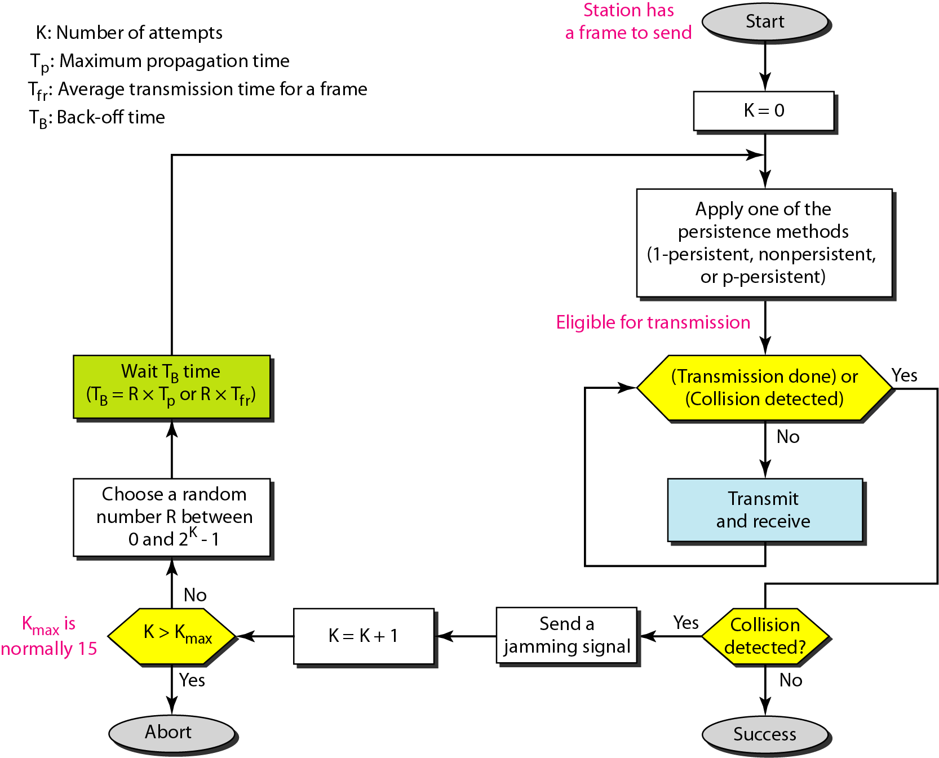
Figure 12.14 Flow diagram for the CSMA/CD

Slide 67
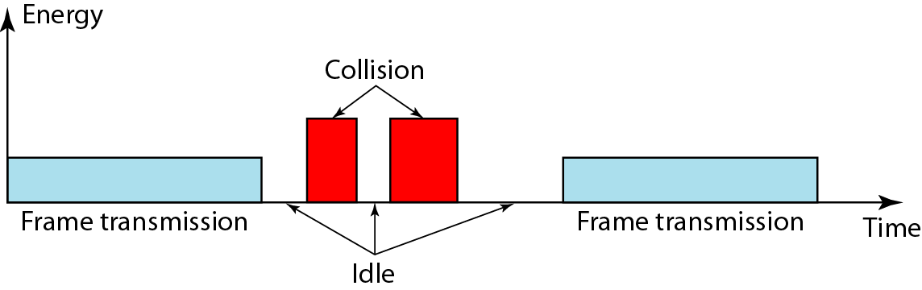
Figure 12.15 Energy level during transmission, idleness, or collision

Slide 68
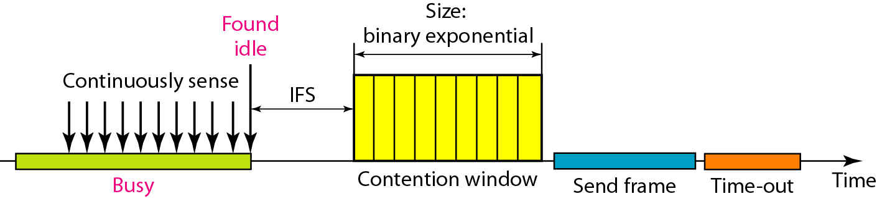
Figure 12.16 Timing in CSMA/CA

Slide 69
Note
In CSMA/CA, the IFS can also be used to define the priority of a station or a frame.

Slide 70
Note
In CSMA/CA, if the station finds the channel busy, it does not restart the timer of the contention window;
it stops the timer and restarts it when the channel becomes idle.

Slide 71
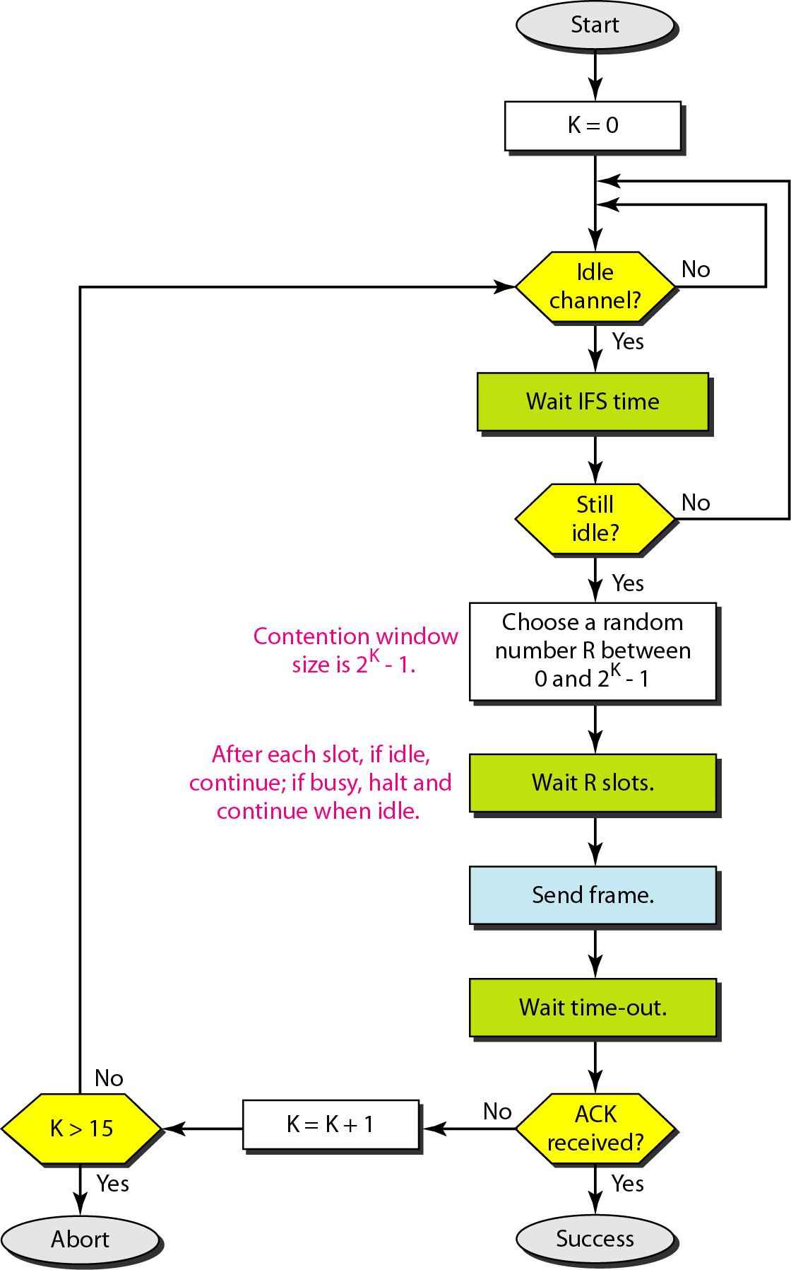
Figure 12.17 Flow diagram for CSMA/CA

Slide 72
12-2 CONTROLLED ACCESS
In controlled access, the stations consult one another to find which station has the right to send. A station cannot send unless it has been authorized by other stations. We discuss three popular controlled-access methods.
Topics discussed in this section:
Reservation
Polling
Token Passing

Slide 73
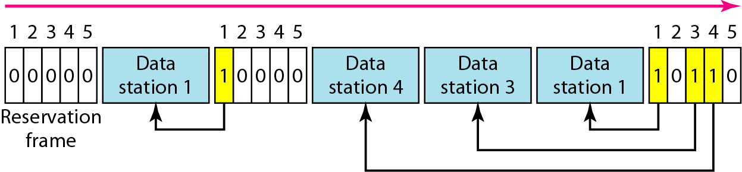
Figure 12.18 Reservation access method

Slide 74
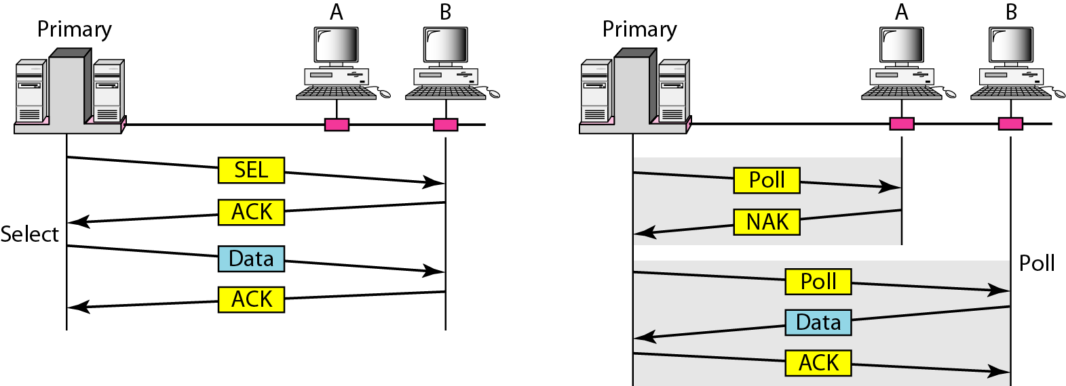
Figure 12.19 Select and poll functions in polling access method

Slide 75
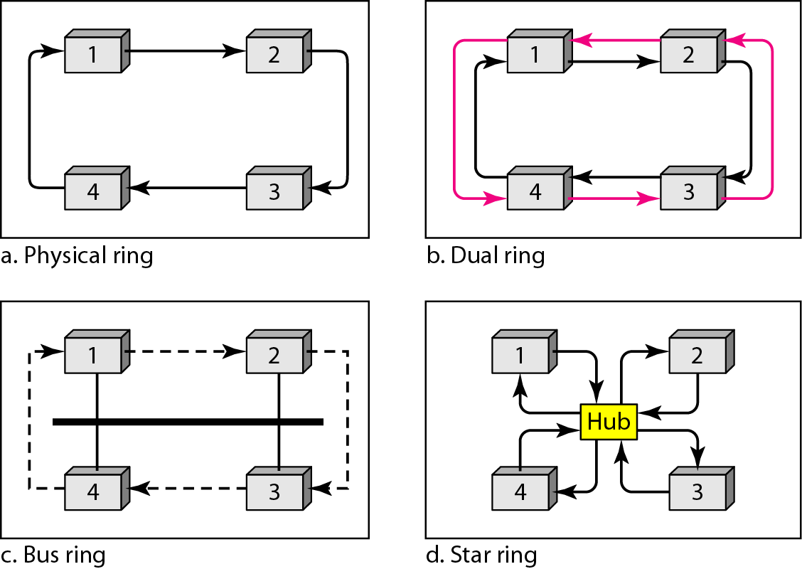
Figure 12.20 Logical ring and physical topology in token-passing access method

Slide 76
12-3 CHANNELIZATION
Channelization is a multiple-access method in which the available bandwidth of a link is shared in time, frequency, or through code, between different stations. In this section, we discuss three channelization protocols.
Topics discussed in this section:
Frequency-Division Multiple Access (FDMA)
Time-Division Multiple Access (TDMA)
Code-Division Multiple Access (CDMA)

Slide 77
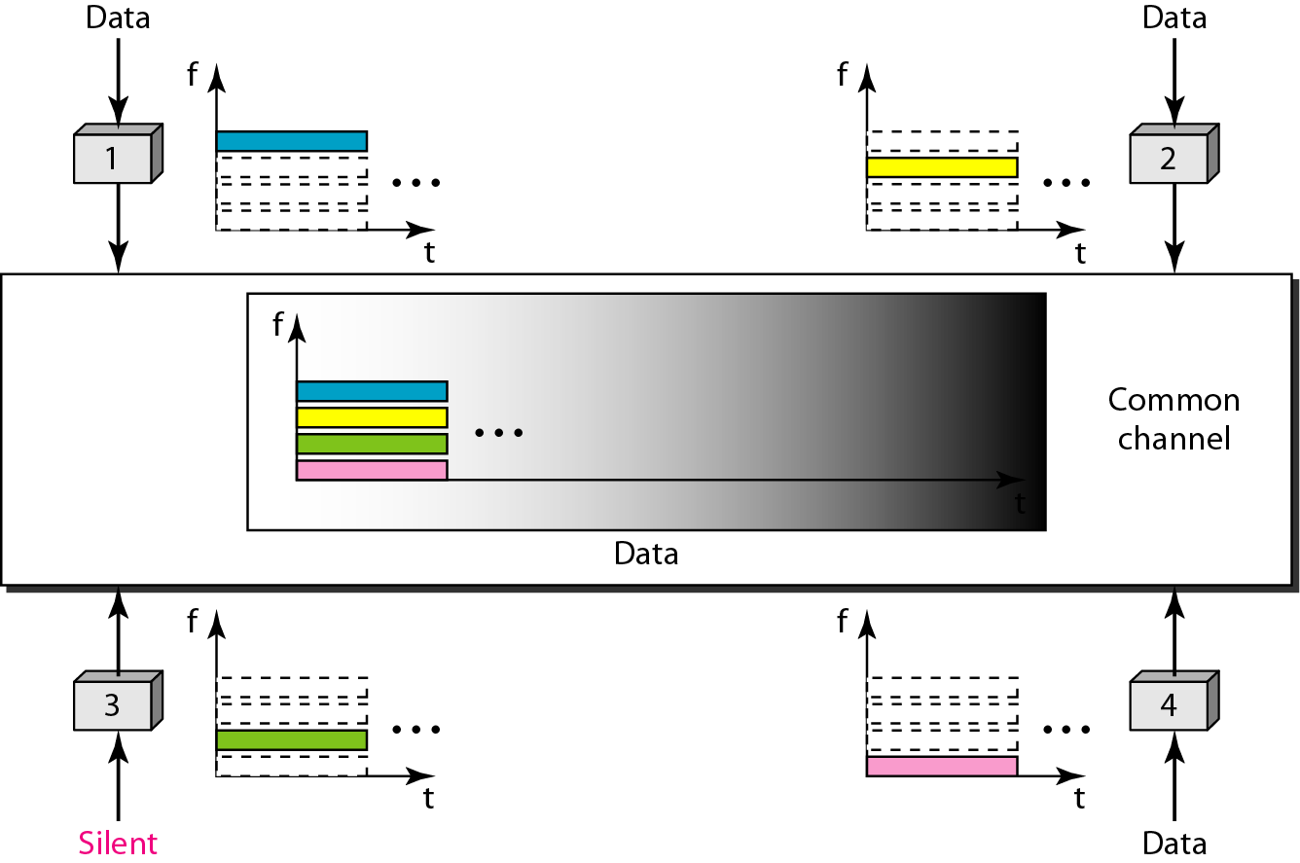
Figure 12.21 Frequency-division multiple access (FDMA)

Slide 78
Note
In FDMA, the available bandwidth
of the common channel is divided into bands that are separated by guard bands.

Slide 79
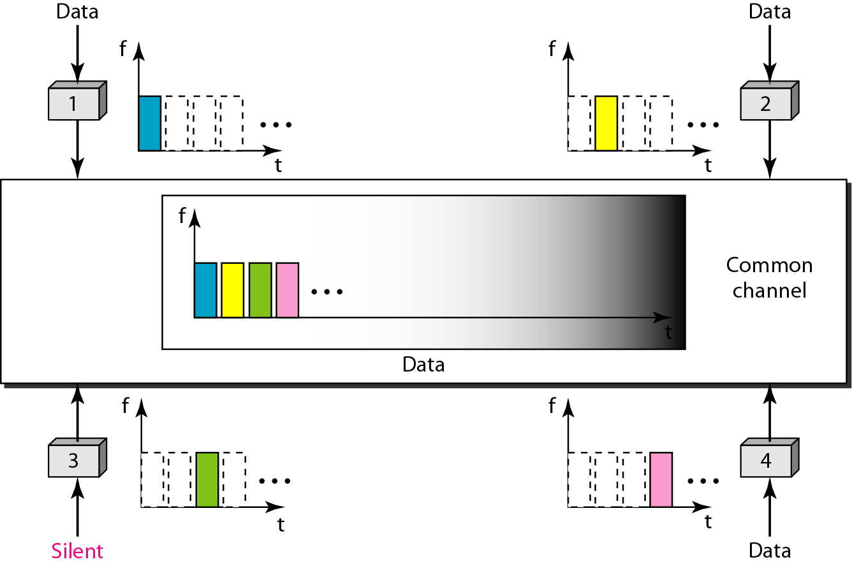
Figure 12.22 Time-division multiple access (TDMA)

Slide 80
Note
In TDMA, the bandwidth is just one channel that is timeshared between different stations.

Slide 81
Note
In CDMA, one channel carries all transmissions simultaneously.

Slide 82
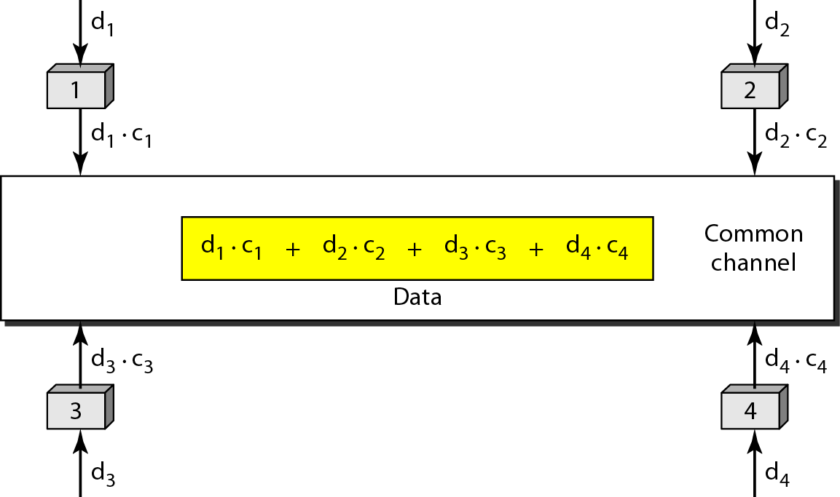
Figure 12.23 Simple idea of communication with code

Slide 83
Figure 12.24 Chip sequences

Slide 84
Figure 12.25 Data representation in CDMA

Slide 85
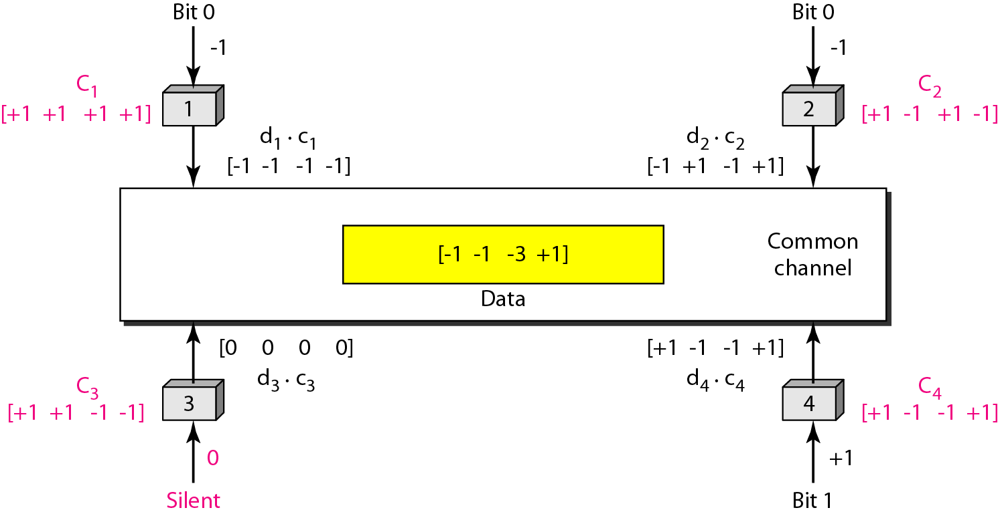
Figure 12.26 Sharing channel in CDMA

Slide 86
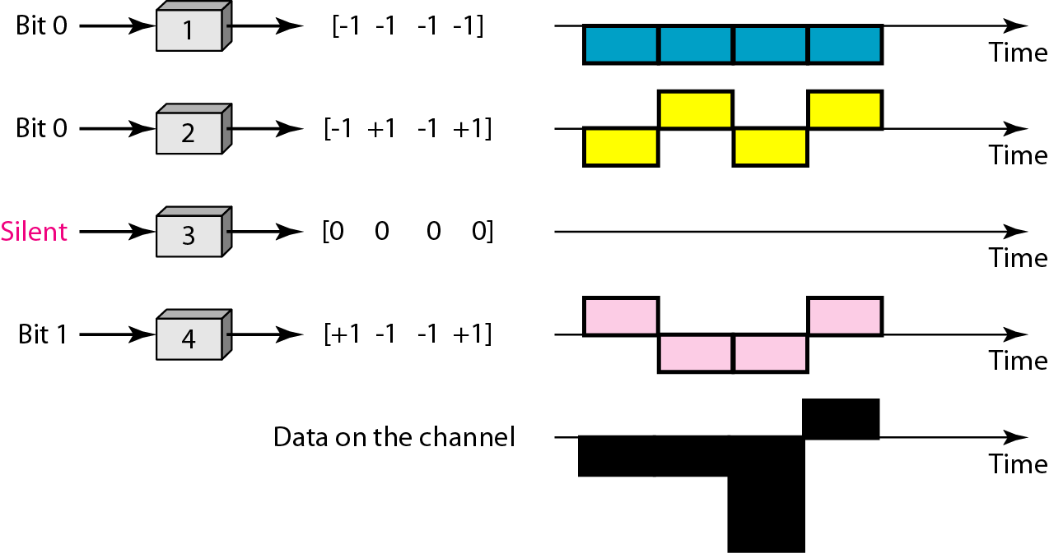
Figure 12.27 Digital signal created by four stations in CDMA

Slide 87
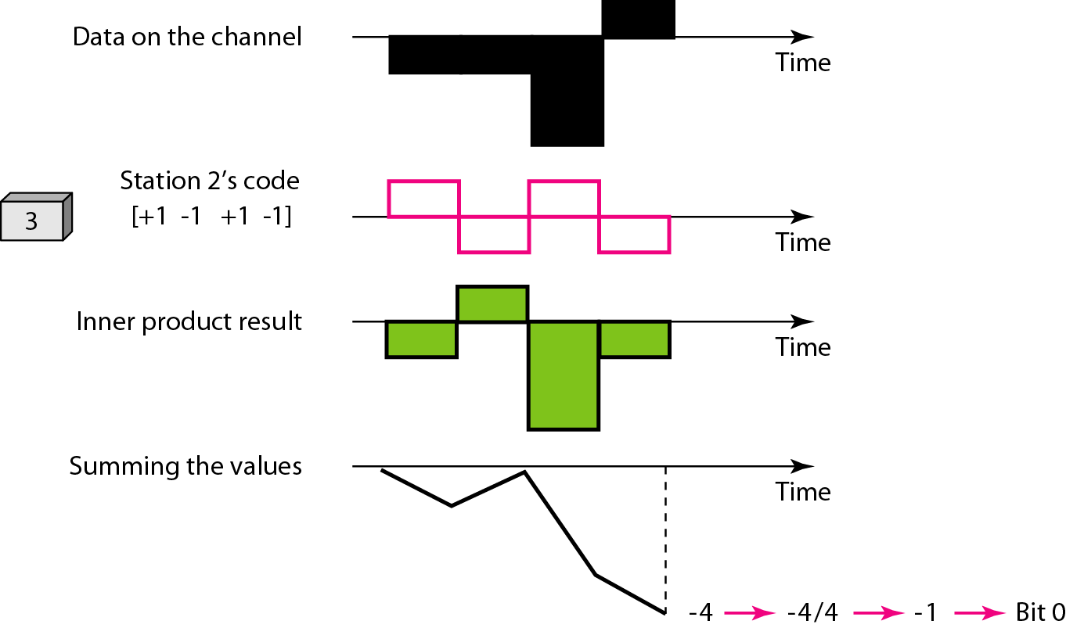
Figure 12.28 Decoding of the composite signal for one in CDMA

Slide 88
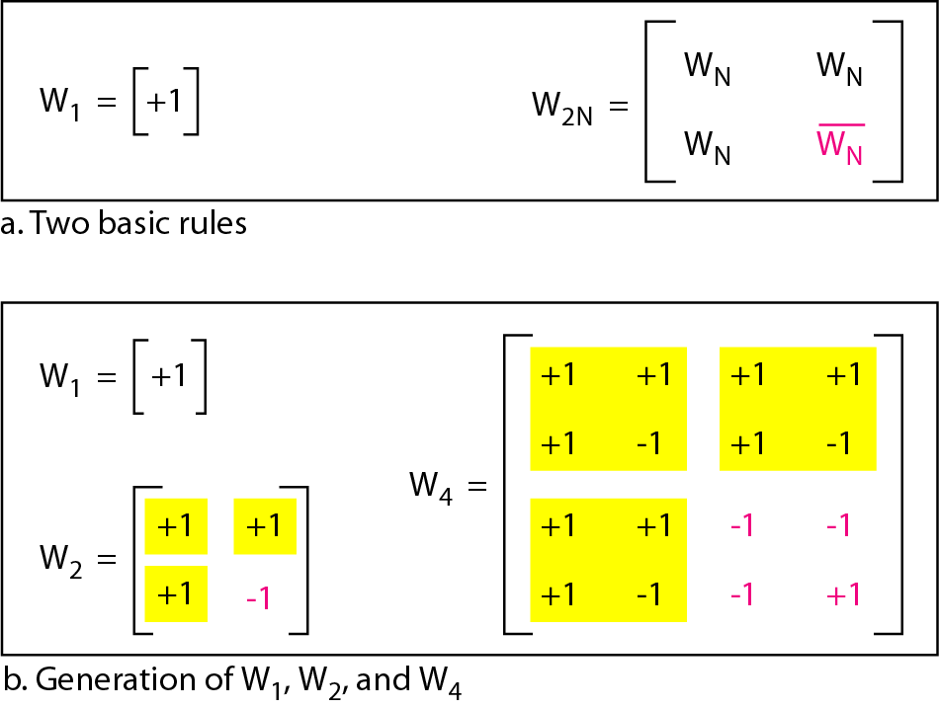
Figure 12.29 General rule and examples of creating Walsh tables

Slide 89
Note
The number of sequences in a Walsh table needs to be N = 2^{m}.

Slide 90
Example 12.6
Find the chips for a network with
a. Two stations b. Four stations
Solution
We can use the rows of W₂ and W₄ in Figure 12.29:
a. For a two-station network, we have
[+1 +1] and [+1 −1].
b. For a four-station network we have
[+1 +1 +1 +1], [+1 −1 +1 −1],
[+1 +1 −1 −1], and [+1 −1 −1 +1].

Slide 91
Example 12.7
What is the number of sequences if we have 90 stations in our network?
Solution
The number of sequences needs to be 2^{m}. We need to choose m = 7 and N = 2⁷ or 128. We can then use 90
of the sequences as the chips.

Slide 92
Example 12.8
Prove that a receiving station can get the data sent by a specific sender if it multiplies the entire data on the channel by the sender’s chip code and then divides it by the number of stations.
Solution
Let us prove this for the first station, using our previous four-station example. We can say that the data on the channel
D = (d₁ ⋅ c₁ + d₂ ⋅ c₂ + d₃ ⋅ c₃ + d₄ ⋅ c₄).
The receiver which wants to get the data sent by station 1 multiplies these data by c₁.

Slide 93
Example 12.8 (continued)
When we divide the result by N, we get d₁ .

